Slide 1
Circles of Assurance
Justification, Sanctification, Glorification

Slide 2
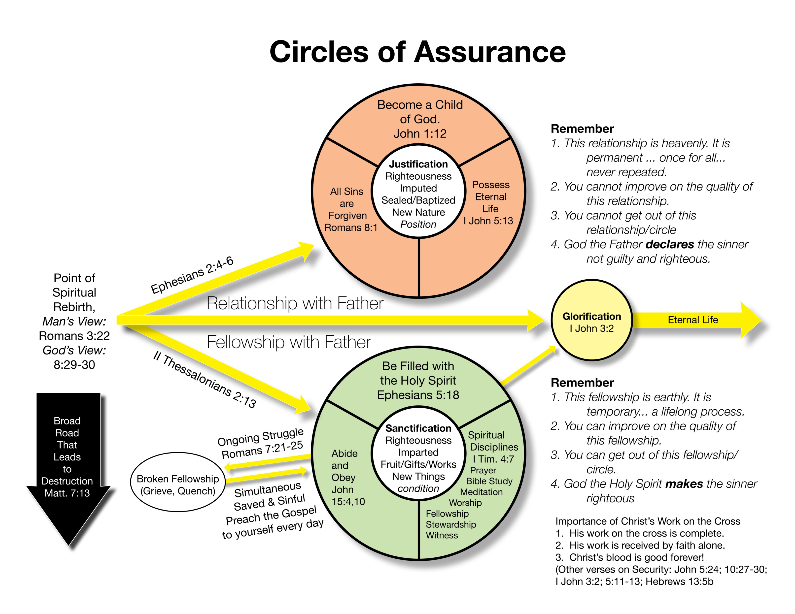

Slide 4
Man’s Point of View
…the righteousness of God through faith in Jesus Christ for all who believe.
Romans 3:22

Slide 5
God’s Point of View
For those whom He foreknew He also predestined to be conformed to the image of His Son, in order that He might be the firstborn among many brothers. And those whom He predestined He also called, and those whom He called He also justified, and those whom He justified He also glorified.
Romans 8:29-30

Slide 6
Only Two Destinies
Enter by the narrow gate. For the gate is wide and the way is easy that leads to destruction, and those who enter by it are many. For the gate is narrow and the way is hard that leads to life, and those who find it are few.
Matthew 7:13, 14

Slide 8
But God, being rich in mercy, because of the great love with which He loved us, even when we were dead in our trespasses, made us alive together with Christ – by grace you have been saved – and raised us up with Him and seated us with Him in the heavenly places in Christ Jesus.
Ephesians 2:4-6

Slide 10
But to all who did receive Him, who believed in His name, He gave the right to become children of God.
John 1:12

Slide 12
There is therefore now no condemnation for those who are in Christ Jesus.
Romans 8:1

Slide 14
I write these things to you who believe in the name of the Son of God that you may know that you have eternal life.
I John 5:13

Slide 20
But we ought always to give thanks to God for you, brothers beloved by the Lord, because God chose you as the firstfruits to be saved, through sanctification by the Spirit and belief in the truth.
II Thessalonians 2:13

Slide 24
Therefore, if anyone is in Christ, he is a new creation. The old has passed away; behold, the new has come.
II Corinthians 5:17

Slide 26
And do not get drunk with wine, for that is debauchery, but be filled with the Spirit.
Ephesians 5:18

Slide 28
Abide in Me, and I in you. As the branch cannot bear fruit by itself, unless it abides in the vine, neither can you, unless you abide in Me. If you keep My commandments, you will abide in My love, just as I have kept My Father’s commandments and abide in His love.
John 15:4, 10

Slide 30
Have nothing to do with irreverent, silly myths. Rather train yourself for godliness.
I Timothy 4:7

Slide 32
For I delight in the law of God, in my inner being, but I see in my members another law waging war against the law of my mind and making me captive to the law of sin that dwells in my members. Wretched man that I am! Who will deliver me from this body of death?
Romans 7:21-25

Slide 35
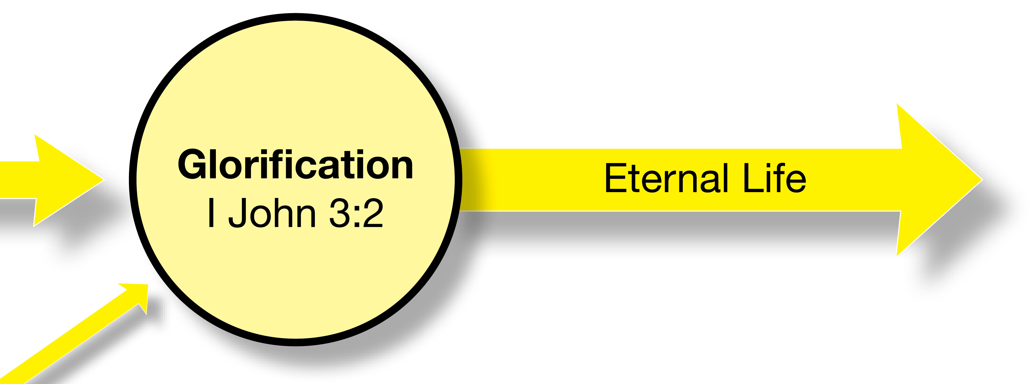

Slide 36
Beloved, we are God’s children now, and what we will be has not yet appeared; but we know that when He appears we shall be like Him, because we shall see Him as He is.
I John 3:2

